Slide 1
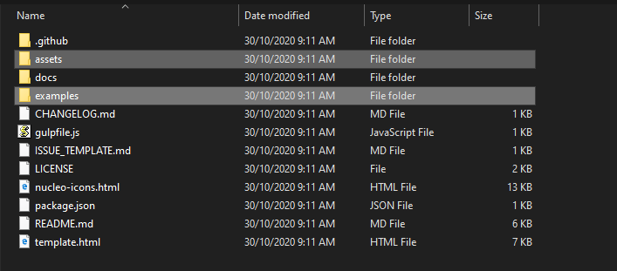
Unit 5 -Admin Panel Setup
Setup Admin Panel using Bootstrap theme
First of all, download a Bootstrap Admin Template. Unzip the template file, we will be using the assets and examples folders.

Slide 2
Step 1: Copy the assets folder and paste it into your Laravel web project public folder.
Step 2: Go to resources-> views create two folder layouts and admin.
Step 3: Create a file name dashboard.blade.php inside the admin folder.
Step 4: Copy the html file from the examples folder, rename it to master.blade.php, and paste it into the layouts folder.

Slide 3
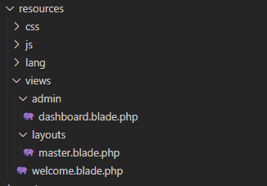

Slide 4
Step 5: Open master.blade.php file, cut the content inside <div class=”content”> … </div> and paste it to dashboard.blade.php. Then replace the content with @yield(‘content’)
Step 6: Open dashboard.blade.php file, insert @section(‘content’) at the first line before the content, and @endsection at the last line.

Slide 5
master.blade.php
...
<div class="content">
@yield('content')
</div>
...dashboard.blade.php
@section('content')
<div class="container-fluid">
...
</div>
@endsection

Slide 6
Step 7: Open the master.blade.php, replace all the resources path as below:
Change
../assets/css/material-dashboard.css?v=2.1.2
To
{{ asset('public/assets/css/material-dashboard.css?v=2.1.2') }}
Step 8: Go to the routes/web.php file, add the URL path for the admin
Route::get('/admin', function () {
return view('admin.dashboard');
});
Now, you can test your site by accessing the URL:
http://localhost/<root-folder name>/admin

Slide 7
Creting Admin Login
Steps to Make Admin Auth in Laravel 8:
Step 1: Create an admin table in the database
Create one migration for admin and add “name, email, password, created_at, updated_at” fields in the “admins” table
Step 2: Add Guards
To add guards, you need to make the following changes in the config/auth.php file.

Slide 8
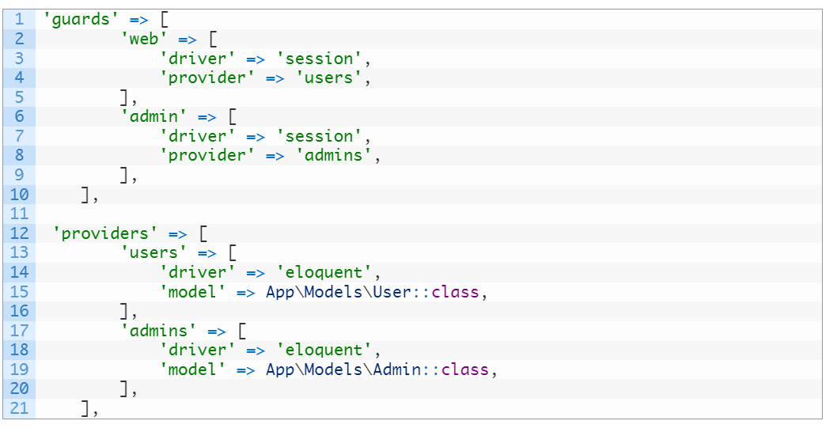

Slide 9
Step 3: Add admin auth middleware
Run the below command
php artisan make:middleware AdminAuthenticated
Now, move to the below path
app/Http/Middleware/AdminAuthenticated.php
And add the code as follows

Slide 10
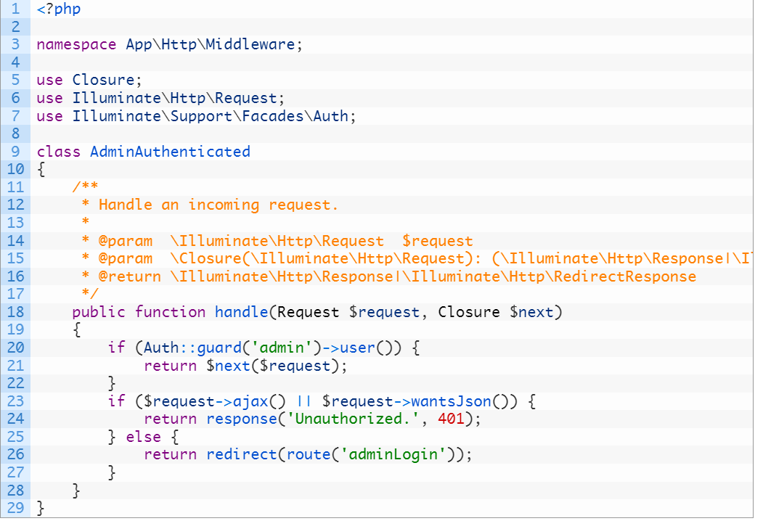

Slide 11
Step 4: Add Middlewave in Kernel.php file
Move to the following path
app/Http/Kernel.php
Now add the code as follow

Slide 12
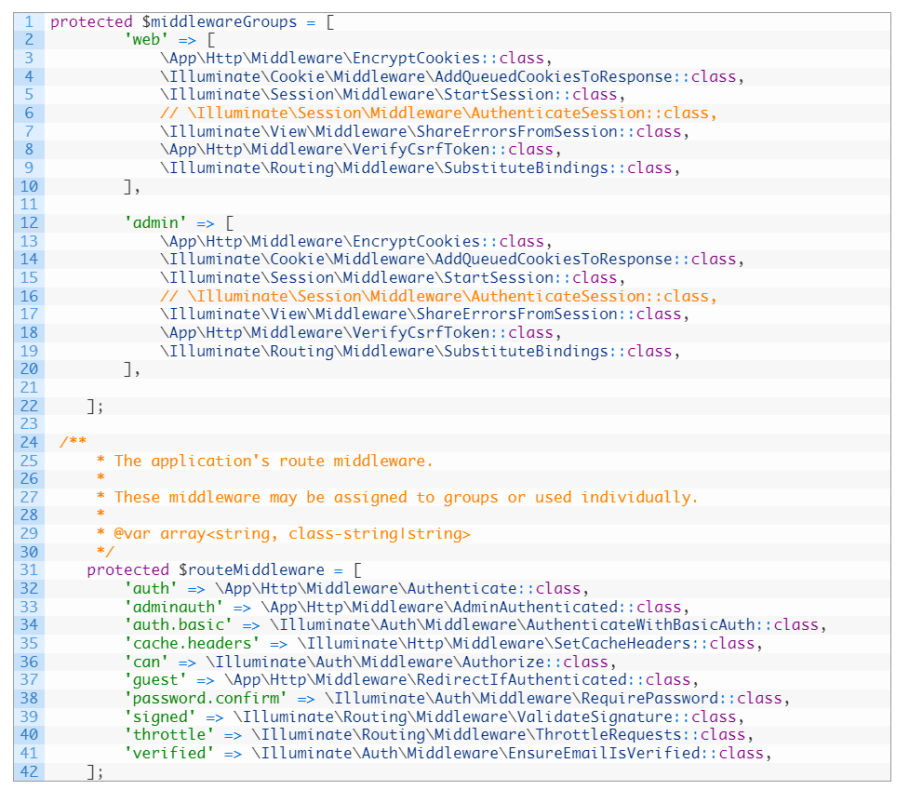

Slide 13
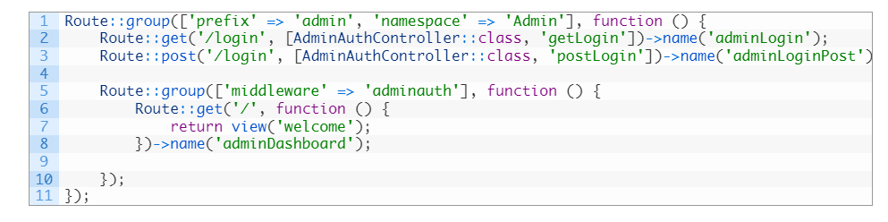
Step 5: Add Admin Login Routes
Go to the below-mentioned path
routes/web.php
Now add the below code

Slide 14
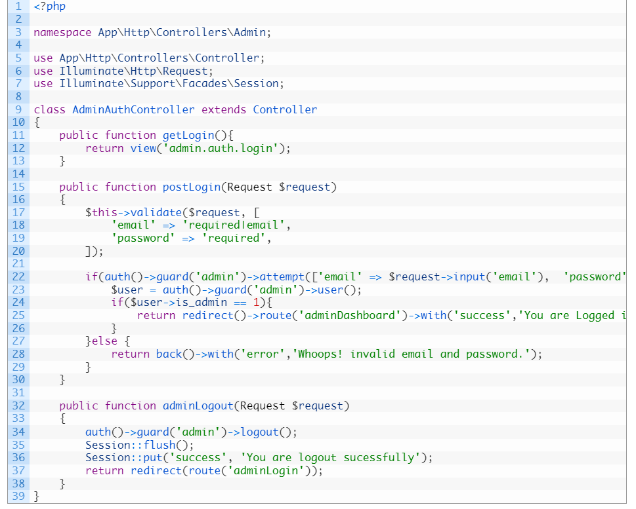
Step 6: Create AdminAuth controller
Run the following command
php artisan make:controller Admin/AdminAuthController
Then navigate to the following path
app/Http/Controllers/Admin/AdminAuthController.php
And add the below code snippet

Slide 15
Step 7: Create a Blade file
Go to the below path
resources\views\admin\auth\login.blade.php
And add the code as follows

Slide 16
<!DOCTYPE html>
<html lang="en">
<head>
<meta charset="UTF-8">
<meta http-equiv="X-UA-Compatible" content="IE=edge">
<meta name="viewport" content="width=device-width, initial-scale=1.0">
<title>Admin Login</title>
</head>

Slide 17
<body class="vertical-layout vertical-menu-modern" data-open="click" data-menu="vertical-menu-modern" data-col="" data-framework="laravel">
<div class="auth-wrapper auth-basic px-2">
<div class="auth-inner my-2">
<!-- Login basic -->
@if(\Session::get('success'))
<div class="alert alert-success alert-dismissible fade show" role="alert">
<div class="alert-body">
{{ \Session::get('success') }}
</div>
<button type="button" class="btn-close" data-bs-dismiss="alert" aria-label="Close"></button>
</div>
@endif
{{ \Session::forget('success') }}
@if(\Session::get('error'))
<div class="alert alert-danger alert-dismissible fade show" role="alert">
<div class="alert-body">
{{ \Session::get('error') }}
</div>
<button type="button" class="btn-close" data-bs-dismiss="alert" aria-label="Close"></button>
</div>
@endif
<div class="card mb-0">
<div class="card-body">
<h2 class="brand-text text-primary ms-1">Admin Login</h2>

Slide 18
<form class="auth-login-form mt-2" action="{{route('adminLoginPost')}}" method="post">
@csrf
<div class="mb-1">
<label for="email" class="form-label">Email</label>
<input type="text" class="form-control" id="email" name="email" value="{{old('email') }}" autofocus />
@if ($errors->has('email'))
<span class="help-block font-red-mint">
<strong>{{ $errors->first('email') }}</strong>
</span>
@endif
</div>
<div class="mb-1">
<div class="d-flex justify-content-between">
<label class="form-label" for="password">Password</label>
<a href="{{url('auth/forgot-password-basic')}}">
<small>Forgot Password?</small>
</a>
</div>

Slide 19
<div class="input-group input-group-merge form-password-toggle">
<input type="password" class="form-control form-control-merge" id="password" name="password" tabindex="2" />
<span class="input-group-text cursor-pointer"><i data-feather="eye"></i></span>
</div>
@if ($errors->has('password'))
<span class="help-block font-red-mint">
<strong>{{ $errors->first('password') }}</strong>
</span>
@endif
</div>
<button type="submit" class="btn btn-primary w-100" tabindex="4">Sign in</button>
</form>
</div>
</div>
<!-- /Login basic -->
</div>
</div>
</body>
</html>

Slide 20
Run your Laravel application
Now, the admin auth is ready for the login. just run your Laravel application using the following command in the terminal.
php artisan serve

Slide 21
Thank You

